Slide 1
Project Scheduling Basics
Activity on Node
Precedence Diagrams
Project Management
Year 4

Slide 2
Precedence Diagrams
ES = Earliest Start Time
EF = Earliest Finish Time
LS = Latest Start Time
LF = Latest Finish Time
D = Activity Duration
TF = Total Float
Activity Box may state:
  Activity Name
  Activity Description
  Resources Required
  Etc.

Slide 3
Precedence Diagram Example
Consider the Project Below
ID | Activity | Duration | IPA
1 | A | 5 | -
2 | B | 7 | A
3 | C | 4 | A
4 | D | 3 | A
5 | E | 3 | C
6 | F | 2 | B
7 | G | 5 | D
8 | H | 8 | E,G
9 | I | 6 | F,H

Slide 4
5
A
Draw the network
Enter the Durations
ID | Activity | Duration | IPA
1 | A | 5 | -
2 | B | 7 | A
3 | C | 4 | A
4 | D | 3 | A
5 | E | 3 | C
6 | F | 2 | B
7 | G | 5 | D
8 | H | 8 | E,G
9 | I | 6 | F,H

Slide 5
7
B
5
A
ID | Activity | Duration | IPA
1 | A | 5 | -
2 | B | 7 | A
3 | C | 4 | A
4 | D | 3 | A
5 | E | 3 | C
6 | F | 2 | B
7 | G | 5 | D
8 | H | 8 | E,G
9 | I | 6 | F,H

Slide 6
7
B
5
4
A
C
ID | Activity | Duration | IPA
1 | A | 5 | -
2 | B | 7 | A
3 | C | 4 | A
4 | D | 3 | A
5 | E | 3 | C
6 | F | 2 | B
7 | G | 5 | D
8 | H | 8 | E,G
9 | I | 6 | F,H

Slide 7
7
B
5
4
A
C
3
D
ID | Activity | Duration | IPA
1 | A | 5 | -
2 | B | 7 | A
3 | C | 4 | A
4 | D | 3 | A
5 | E | 3 | C
6 | F | 2 | B
7 | G | 5 | D
8 | H | 8 | E,G
9 | I | 6 | F,H

Slide 8
7
B
5
4
A
C
3
D
ID | Activity | Duration | IPA
1 | A | 5 | -
2 | B | 7 | A
3 | C | 4 | A
4 | D | 3 | A
5 | E | 3 | C
6 | F | 2 | B
7 | G | 5 | D
8 | H | 8 | E,G
9 | I | 6 | F,H

Slide 9
7
B
5
4
3
A
C
E
3
D
ID | Activity | Duration | IPA
1 | A | 5 | -
2 | B | 7 | A
3 | C | 4 | A
4 | D | 3 | A
5 | E | 3 | C
6 | F | 2 | B
7 | G | 5 | D
8 | H | 8 | E,G
9 | I | 6 | F,H

Slide 10
7
B
5
4
3
A
C
E
3
D
ID | Activity | Duration | IPA
1 | A | 5 | -
2 | B | 7 | A
3 | C | 4 | A
4 | D | 3 | A
5 | E | 3 | C
6 | F | 2 | B
7 | G | 5 | D
8 | H | 8 | E,G
9 | I | 6 | F,H

Slide 11
7
2
B
F
5
4
3
A
C
E
3
D
ID | Activity | Duration | IPA
1 | A | 5 | -
2 | B | 7 | A
3 | C | 4 | A
4 | D | 3 | A
5 | E | 3 | C
6 | F | 2 | B
7 | G | 5 | D
8 | H | 8 | E,G
9 | I | 6 | F,H

Slide 12
7
2
B
F
5
4
3
A
C
E
3
5
D
G
ID | Activity | Duration | IPA
1 | A | 5 | -
2 | B | 7 | A
3 | C | 4 | A
4 | D | 3 | A
5 | E | 3 | C
6 | F | 2 | B
7 | G | 5 | D
8 | H | 8 | E,G
9 | I | 6 | F,H

Slide 13
7
2
B
F
5
4
3
8
A
C
E
H
3
5
D
G
ID | Activity | Duration | IPA
1 | A | 5 | -
2 | B | 7 | A
3 | C | 4 | A
4 | D | 3 | A
5 | E | 3 | C
6 | F | 2 | B
7 | G | 5 | D
8 | H | 8 | E,G
9 | I | 6 | F,H

Slide 14
7
2
B
F
5
4
3
8
A
C
E
H
3
5
D
G
ID | Activity | Duration | IPA
1 | A | 5 | -
2 | B | 7 | A
3 | C | 4 | A
4 | D | 3 | A
5 | E | 3 | C
6 | F | 2 | B
7 | G | 5 | D
8 | H | 8 | E,G
9 | I | 6 | F,H

Slide 15
7
2
B
F
5
4
3
8
6
A
C
E
H
I
3
5
D
G
ID | Activity | Duration | IPA
1 | A | 5 | -
2 | B | 7 | A
3 | C | 4 | A
4 | D | 3 | A
5 | E | 3 | C
6 | F | 2 | B
7 | G | 5 | D
8 | H | 8 | E,G
9 | I | 6 | F,H

Slide 16
7
2
B
F
5
4
3
8
6
A
C
E
H
I
3
5
D
G
ID | Activity | Duration | IPA
1 | A | 5 | -
2 | B | 7 | A
3 | C | 4 | A
4 | D | 3 | A
5 | E | 3 | C
6 | F | 2 | B
7 | G | 5 | D
8 | H | 8 | E,G
9 | I | 6 | F,H

Slide 17
7
2
B
F
5
4
3
8
6
A
C
E
H
I
3
5
D
G
ID | Activity | Duration | IPA
1 | A | 5 | -
2 | B | 7 | A
3 | C | 4 | A
4 | D | 3 | A
5 | E | 3 | C
6 | F | 2 | B
7 | G | 5 | D
8 | H | 8 | E,G
9 | I | 6 | F,H

Slide 18
7
2
B
F
0
5
5
4
3
8
6
A
C
E
H
I
3
5
D
G
The Earliest Start Time is Time 0 (start of Day 1)
Add the ES to the Duration (D) to get the Earliest Finish Time
ID | Activity | Duration | IPA
1 | A | 5 | -
2 | B | 7 | A
3 | C | 4 | A
4 | D | 3 | A
5 | E | 3 | C
6 | F | 2 | B
7 | G | 5 | D
8 | H | 8 | E,G
9 | I | 6 | F,H

Slide 19
5
7
2
B
F
0
5
5
5
4
3
8
6
A
C
E
H
I
5
3
5
D
G
The EF Time of Activity A now becomes the ES Time of Activities B, C, and D
ID | Activity | Duration | IPA
1 | A | 5 | -
2 | B | 7 | A
3 | C | 4 | A
4 | D | 3 | A
5 | E | 3 | C
6 | F | 2 | B
7 | G | 5 | D
8 | H | 8 | E,G
9 | I | 6 | F,H

Slide 20
5
7
12
2
B
F
0
5
5
5
4
9
3
8
6
A
C
E
H
I
5
3
8
5
D
G
As before, add the ES to the D to get the EF of each activity
ID | Activity | Duration | IPA
1 | A | 5 | -
2 | B | 7 | A
3 | C | 4 | A
4 | D | 3 | A
5 | E | 3 | C
6 | F | 2 | B
7 | G | 5 | D
8 | H | 8 | E,G
9 | I | 6 | F,H

Slide 21
5
7
12
12
2
B
F
0
5
5
5
4
9
9
3
8
6
A
C
E
H
I
5
3
8
8
5
D
G
As before, the EF becomes the ES of the following activity
ID | Activity | Duration | IPA
1 | A | 5 | -
2 | B | 7 | A
3 | C | 4 | A
4 | D | 3 | A
5 | E | 3 | C
6 | F | 2 | B
7 | G | 5 | D
8 | H | 8 | E,G
9 | I | 6 | F,H

Slide 22
5
7
12
12
2
14
B
F
0
5
5
5
4
9
9
3
12
8
6
A
C
E
H
I
5
3
8
8
5
13
D
G
Calculate the EF
ID | Activity | Duration | IPA
1 | A | 5 | -
2 | B | 7 | A
3 | C | 4 | A
4 | D | 3 | A
5 | E | 3 | C
6 | F | 2 | B
7 | G | 5 | D
8 | H | 8 | E,G
9 | I | 6 | F,H

Slide 23
5
7
12
12
2
14
B
F
0
5
5
5
4
9
9
3
12
8
6
A
C
E
H
I
5
3
8
8
5
13
D
G
This time we have 2 different EF’s.
Activity ‘H’ cannot commence until both E and G are complete
The earliest time that this will happen is upon completion of Activity G (i.e. Day 13)
ID | Activity | Duration | IPA
1 | A | 5 | -
2 | B | 7 | A
3 | C | 4 | A
4 | D | 3 | A
5 | E | 3 | C
6 | F | 2 | B
7 | G | 5 | D
8 | H | 8 | E,G
9 | I | 6 | F,H

Slide 24
5
7
12
12
2
14
B
F
0
5
5
5
4
9
9
3
12
13
8
6
A
C
E
H
I
5
3
8
8
5
13
D
G
So Day 13, the EF of Activity ‘G’ becomes the ES of Activity ‘H’
ID | Activity | Duration | IPA
1 | A | 5 | -
2 | B | 7 | A
3 | C | 4 | A
4 | D | 3 | A
5 | E | 3 | C
6 | F | 2 | B
7 | G | 5 | D
8 | H | 8 | E,G
9 | I | 6 | F,H

Slide 25
5
7
12
12
2
14
B
F
0
5
5
5
4
9
9
3
12
13
8
21
6
A
C
E
H
I
5
3
8
8
5
13
D
G
Again, two activities are converging. In this case ‘H’ and ‘F’ onto ‘I’
The same rules are applied
ID | Activity | Duration | IPA
1 | A | 5 | -
2 | B | 7 | A
3 | C | 4 | A
4 | D | 3 | A
5 | E | 3 | C
6 | F | 2 | B
7 | G | 5 | D
8 | H | 8 | E,G
9 | I | 6 | F,H

Slide 26
5
7
12
12
2
14
B
F
0
5
5
5
4
9
9
3
12
13
8
21
21
6
27
A
C
E
H
I
5
3
8
8
5
13
D
G
So, Day 21 becomes the ES of Activity ‘I’
ID | Activity | Duration | IPA
1 | A | 5 | -
2 | B | 7 | A
3 | C | 4 | A
4 | D | 3 | A
5 | E | 3 | C
6 | F | 2 | B
7 | G | 5 | D
8 | H | 8 | E,G
9 | I | 6 | F,H

Slide 27
5
7
12
12
2
14
B
F
0
5
5
5
4
9
9
3
12
13
8
21
21
6
27
A
C
E
H
I
5
3
8
8
5
13
D
G
We have now determined that the duration of the project will be 27 days
Precedence Diagrams are a Deterministic Method of estimating Project Duration
ID | Activity | Duration | IPA
1 | A | 5 | -
2 | B | 7 | A
3 | C | 4 | A
4 | D | 3 | A
5 | E | 3 | C
6 | F | 2 | B
7 | G | 5 | D
8 | H | 8 | E,G
9 | I | 6 | F,H

Slide 28
5
7
12
12
2
14
B
F
0
5
5
5
4
9
9
3
12
13
8
21
21
6
27
A
C
E
H
I
27
5
3
8
8
5
13
D
G
We now use the EF as the LF of the final activity to commence what is known as the ‘backwards pass’
ID | Activity | Duration | IPA
1 | A | 5 | -
2 | B | 7 | A
3 | C | 4 | A
4 | D | 3 | A
5 | E | 3 | C
6 | F | 2 | B
7 | G | 5 | D
8 | H | 8 | E,G
9 | I | 6 | F,H

Slide 29
5
7
12
12
2
14
B
F
0
5
5
5
4
9
9
3
12
13
8
21
21
6
27
A
C
E
H
I
21
27
5
3
8
8
5
13
D
G
This time we subtract the duration (6 days) from our LF to give the LS
ID | Activity | Duration | IPA
1 | A | 5 | -
2 | B | 7 | A
3 | C | 4 | A
4 | D | 3 | A
5 | E | 3 | C
6 | F | 2 | B
7 | G | 5 | D
8 | H | 8 | E,G
9 | I | 6 | F,H

Slide 30
5
7
12
12
2
14
B
F
21
0
5
5
5
4
9
9
3
12
13
8
21
21
6
27
A
C
E
H
I
21
21
27
5
3
8
8
5
13
D
G
And, as before we use the LS of the successor (I) to determine the LF of its immediate predecessors (F and H)
ID | Activity | Duration | IPA
1 | A | 5 | -
2 | B | 7 | A
3 | C | 4 | A
4 | D | 3 | A
5 | E | 3 | C
6 | F | 2 | B
7 | G | 5 | D
8 | H | 8 | E,G
9 | I | 6 | F,H

Slide 31
5
7
12
12
2
14
B
F
19
21
0
5
5
5
4
9
9
3
12
13
8
21
21
6
27
A
C
E
H
I
13
21
21
27
5
3
8
8
5
13
D
G
Again, we calculate the LS values
ID | Activity | Duration | IPA
1 | A | 5 | -
2 | B | 7 | A
3 | C | 4 | A
4 | D | 3 | A
5 | E | 3 | C
6 | F | 2 | B
7 | G | 5 | D
8 | H | 8 | E,G
9 | I | 6 | F,H

Slide 32
5
7
12
12
2
14
B
F
19
19
21
0
5
5
5
4
9
9
3
12
13
8
21
21
6
27
A
C
E
H
I
13
13
21
21
27
5
3
8
8
5
13
D
G
13
ID | Activity | Duration | IPA
1 | A | 5 | -
2 | B | 7 | A
3 | C | 4 | A
4 | D | 3 | A
5 | E | 3 | C
6 | F | 2 | B
7 | G | 5 | D
8 | H | 8 | E,G
9 | I | 6 | F,H

Slide 33
5
7
12
12
2
14
B
F
12
19
19
21
0
5
5
5
4
9
9
3
12
13
8
21
21
6
27
A
C
E
H
I
10
13
13
21
21
27
5
3
8
8
5
13
D
G
8
13
Now we are starting to converge on an activity. This time Activity A.
We do not transfer in the LS until we have calculated all the LS values that could be associated with a predecessor
ID | Activity | Duration | IPA
1 | A | 5 | -
2 | B | 7 | A
3 | C | 4 | A
4 | D | 3 | A
5 | E | 3 | C
6 | F | 2 | B
7 | G | 5 | D
8 | H | 8 | E,G
9 | I | 6 | F,H

Slide 34
5
7
12
12
2
14
B
F
12
19
19
21
0
5
5
5
4
9
9
3
12
13
8
21
21
6
27
A
C
E
H
I
10
10
13
13
21
21
27
5
3
8
8
5
13
D
G
8
8
13
ID | Activity | Duration | IPA
1 | A | 5 | -
2 | B | 7 | A
3 | C | 4 | A
4 | D | 3 | A
5 | E | 3 | C
6 | F | 2 | B
7 | G | 5 | D
8 | H | 8 | E,G
9 | I | 6 | F,H

Slide 35
5
7
12
12
2
14
B
F
12
19
19
21
0
5
5
5
4
9
9
3
12
13
8
21
21
6
27
A
C
E
H
I
6
10
10
13
13
21
21
27
5
3
8
8
5
13
D
G
5
8
8
13
Now that all of the values are calculated we can see that they differ
ID | Activity | Duration | IPA
1 | A | 5 | -
2 | B | 7 | A
3 | C | 4 | A
4 | D | 3 | A
5 | E | 3 | C
6 | F | 2 | B
7 | G | 5 | D
8 | H | 8 | E,G
9 | I | 6 | F,H

Slide 36
5
7
12
12
2
14
B
F
12
19
19
21
0
5
5
5
4
9
9
3
12
13
8
21
21
6
27
A
C
E
H
I
5
6
10
10
13
13
21
21
27
5
3
8
8
5
13
D
G
5
8
8
13
The lowest value of the three alternatives is selected.
If one of the others is selected, it would violate the LS date of Activity ‘C’
ID | Activity | Duration | IPA
1 | A | 5 | -
2 | B | 7 | A
3 | C | 4 | A
4 | D | 3 | A
5 | E | 3 | C
6 | F | 2 | B
7 | G | 5 | D
8 | H | 8 | E,G
9 | I | 6 | F,H

Slide 37
5
7
12
12
2
14
B
F
12
19
19
21
0
5
5
5
4
9
9
3
12
13
8
21
21
6
27
A
C
E
H
I
0
5
6
10
10
13
13
21
21
27
5
3
8
8
5
13
D
G
5
8
8
13
Again we calculate the LS for the activity
ID | Activity | Duration | IPA
1 | A | 5 | -
2 | B | 7 | A
3 | C | 4 | A
4 | D | 3 | A
5 | E | 3 | C
6 | F | 2 | B
7 | G | 5 | D
8 | H | 8 | E,G
9 | I | 6 | F,H

Slide 38
5
7
12
12
2
14
B
F
12
19
19
21
0
5
5
5
4
9
9
3
12
13
8
21
21
6
27
A
C
E
H
I
0
0
5
6
10
10
13
13
21
21
27
5
3
8
8
5
13
D
G
5
8
8
13
The next item that we are interested in is the Total Float associated with each activity
This is calculated by subtracting the ES from the LS (LS-ES = TF)
It can also be calculated by subtracting the EF from the LF (or LF – EF = TF)
ID | Activity | Duration | IPA
1 | A | 5 | -
2 | B | 7 | A
3 | C | 4 | A
4 | D | 3 | A
5 | E | 3 | C
6 | F | 2 | B
7 | G | 5 | D
8 | H | 8 | E,G
9 | I | 6 | F,H

Slide 39
5
7
12
12
2
14
B
F
12
7
19
19
21
0
5
5
5
4
9
9
3
12
13
8
21
21
6
27
A
C
E
H
I
0
0
5
6
10
10
13
13
21
21
27
5
3
8
8
5
13
D
G
5
8
8
13
So we parse the network going calculating the TF values for each activity
ID | Activity | Duration | IPA
1 | A | 5 | -
2 | B | 7 | A
3 | C | 4 | A
4 | D | 3 | A
5 | E | 3 | C
6 | F | 2 | B
7 | G | 5 | D
8 | H | 8 | E,G
9 | I | 6 | F,H

Slide 40
5
7
12
12
2
14
B
F
12
7
19
19
21
0
5
5
5
4
9
9
3
12
13
8
21
21
6
27
A
C
E
H
I
0
0
5
6
1
10
10
13
13
21
21
27
5
3
8
8
5
13
D
G
5
8
8
13
ID | Activity | Duration | IPA
1 | A | 5 | -
2 | B | 7 | A
3 | C | 4 | A
4 | D | 3 | A
5 | E | 3 | C
6 | F | 2 | B
7 | G | 5 | D
8 | H | 8 | E,G
9 | I | 6 | F,H

Slide 41
5
7
12
12
2
14
B
F
12
7
19
19
21
0
5
5
5
4
9
9
3
12
13
8
21
21
6
27
A
C
E
H
I
0
0
5
6
1
10
10
13
13
21
21
27
5
3
8
8
5
13
D
G
5
0
8
8
13
ID | Activity | Duration | IPA
1 | A | 5 | -
2 | B | 7 | A
3 | C | 4 | A
4 | D | 3 | A
5 | E | 3 | C
6 | F | 2 | B
7 | G | 5 | D
8 | H | 8 | E,G
9 | I | 6 | F,H

Slide 42
5
7
12
12
2
14
B
F
12
7
19
19
7
21
0
5
5
5
4
9
9
3
12
13
8
21
21
6
27
A
C
E
H
I
0
0
5
6
1
10
10
1
13
13
21
21
27
5
3
8
8
5
13
D
G
5
0
8
8
0
13
ID | Activity | Duration | IPA
1 | A | 5 | -
2 | B | 7 | A
3 | C | 4 | A
4 | D | 3 | A
5 | E | 3 | C
6 | F | 2 | B
7 | G | 5 | D
8 | H | 8 | E,G
9 | I | 6 | F,H

Slide 43
5
7
12
12
2
14
B
F
12
7
19
19
7
21
0
5
5
5
4
9
9
3
12
13
8
21
21
6
27
A
C
E
H
I
0
0
5
6
1
10
10
1
13
13
0
21
21
0
27
5
3
8
8
5
13
D
G
5
0
8
8
0
13
ID | Activity | Duration | IPA
1 | A | 5 | -
2 | B | 7 | A
3 | C | 4 | A
4 | D | 3 | A
5 | E | 3 | C
6 | F | 2 | B
7 | G | 5 | D
8 | H | 8 | E,G
9 | I | 6 | F,H

Slide 44
5
7
12
12
2
14
B
F
12
7
19
19
7
21
0
5
5
5
4
9
9
3
12
13
8
21
21
6
27
A
C
E
H
I
0
0
5
6
1
10
10
1
13
13
0
21
21
0
27
5
3
8
8
5
13
D
G
5
0
8
8
0
13
Next, identify all activities that have a TF of zero
ID | Activity | Duration | IPA
1 | A | 5 | -
2 | B | 7 | A
3 | C | 4 | A
4 | D | 3 | A
5 | E | 3 | C
6 | F | 2 | B
7 | G | 5 | D
8 | H | 8 | E,G
9 | I | 6 | F,H

Slide 45
5
7
12
12
2
14
B
F
12
7
19
19
7
21
0
5
5
5
4
9
9
3
12
13
8
21
21
6
27
A
C
E
H
I
0
0
5
6
1
10
10
1
13
13
0
21
21
0
27
5
3
8
8
5
13
D
G
5
0
8
8
0
13
Activities with Zero float make up the critical path
Therefore the Critical Path is A-D-G-H-I
ID | Activity | Duration | IPA
1 | A | 5 | -
2 | B | 7 | A
3 | C | 4 | A
4 | D | 3 | A
5 | E | 3 | C
6 | F | 2 | B
7 | G | 5 | D
8 | H | 8 | E,G
9 | I | 6 | F,H

Slide 46
Critical Path
In the example, activities ADGHI are driving the duration of the project. A delay in any of these activities will extend the duration of the project
  i.e if activity H is delayed by 2 days the overall project will not be completed until Day 29
  The project will not be delayed if activities B and F are delayed by 2 days
  There are limits. If activities C or E are delayed by 2 days, they will become critical, and the new critical path will be ACEHI

Slide 47
5
7
12
12
2
14
B
F
12
7
19
19
7
21
Increased from 3 days to 5
0
5
5
5
4
9
9
5
14
14
8
22
22
6
28
A
C
E
H
I
0
0
5
5
0
9
9
0
14
14
0
22
22
0
28
5
3
8
8
5
13
D
G
6
1
9
9
1
14
Increasing the duration of Task E from 3 days to 5 days changes the critical path of the network
This would likely occur on a project during execution, and highlights the importance of ensuring all activities are managed and controlled – not just those on the critical path

Slide 48
Critical Path
General Observations
  In every network at least 1 critical path must exist
  More then one critical path may exist
  Any critical path must be continuous from the start to the end of the project
  Unless a constraint is imposed, a path cannot be partially critical. The entire path is either critical or non critical
  If all paths go through a particular activity, then that activity must be critical, ie ‘A’ and ‘I’ in the example
  Sometimes the critical path is defined as ‘the path with zero float’. This definition is only correct if there is no imposed finish date in the backwards pass calculations
  We will define the Critical Path as ‘the longest path in the network’. It always holds true.

Slide 49
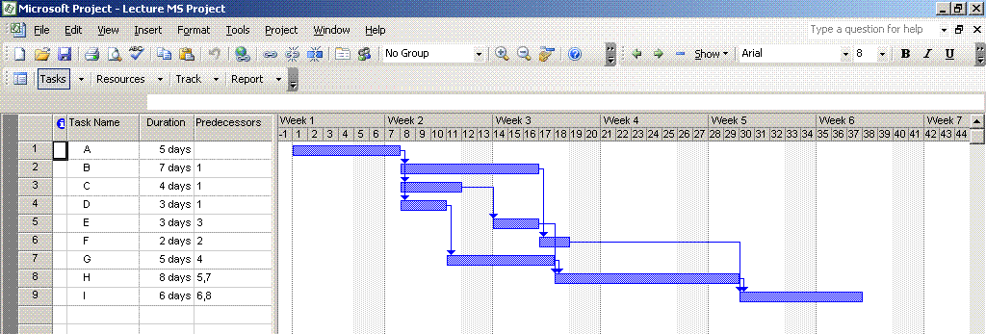
Microsoft Project – Gantt Chart
View | Gantt Chart

Slide 50
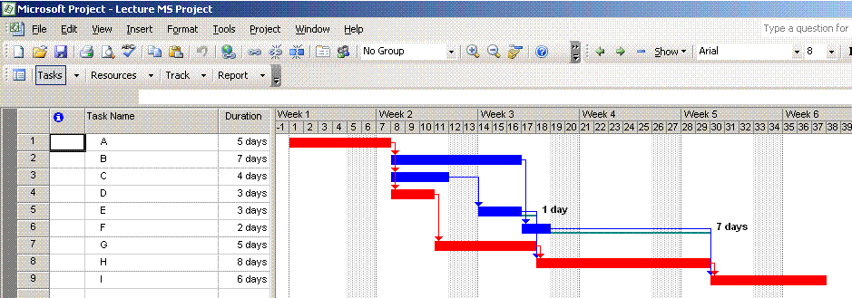
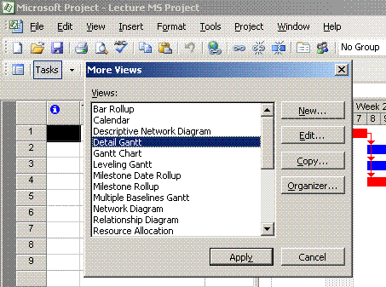
MS Project – Detailed Gantt Chart
View | More Views |
Detail Gantt

Slide 51
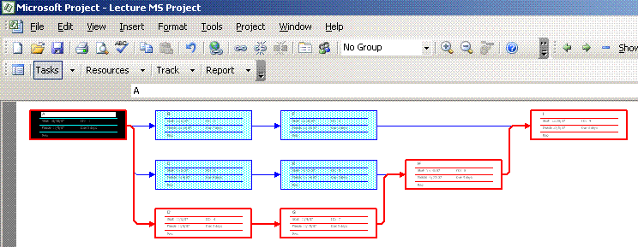
MS Project – Network Diagram
View | Network Diagram

Slide 52
Task Relationships
So far we have assumed that a preceding task needs to be completed before a successor can start. This is known as a Finish-Start (FS) relationship
However, there are in fact 4 task relationships
    Finish-Start (FS)
    Start-Start (SS)
    Finish-Finish (FF)
    Start-Finish (SF)

Slide 53
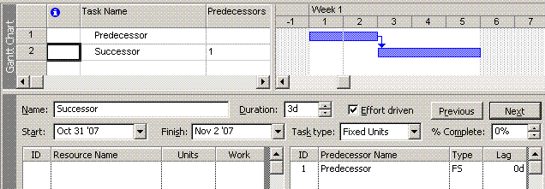
Finish-Start (FS)
0
2
2
2
3
5
P
S
0
0
2
2
0
5
Most common relationship
Default relationship for most project scheduling software
Concrete cannot be poured until formwork is in place
Block work cannot start until foundation is complete

Slide 54
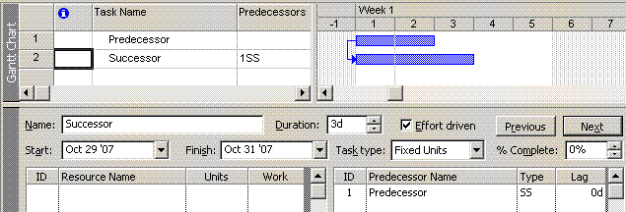
Start-Start (SS)
0
2
2
0
3
3
P
S
0
0
2
0
0
3
Commonly used; very useful
Often used with a lag
Commence landscaping when snag-list is starting
Commence laying underground pipe 3 days (lag) after excavation has started

Slide 55
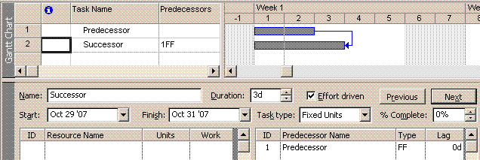
Finish-Finish (FF)
0
2
2
0
3
3
P
S
1
1
3
0
0
3
Again, commonly used and very useful
Beware when running forward and backwards pass
  See above, LF of ‘S’ becomes LF of ‘P’
As-Built drawings and substantial completion must finish together

Slide 56
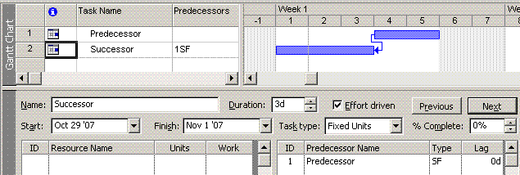
Start-Finish (SF)
3
2
5
0
3
3
P
S
3
0
5
0
0
3
Rarely (if ever) used; avoid if possible
  Creates complexity; ‘end of day’ and ‘start of day’ become vital for correct analysis.
  Rarely makes logical sense.
Can be used to schedule backwards from a specific event, such as a submission of a tender. However it is better to use a constraint.

Slide 57
Lags
Lag is not the same as ‘Float’
Lag is minimum delay between the end (or start) of an activity and the start (or end) of is successor
The delay can exceed the minimum, provided it does not violate some other logic or constraint
Lags can be introduced to cater for non-resource associated times, such as the time allowed for concrete to cure.
0
2
2
4
3
7
2 days
P
S
2
2
6
8
2
11
2 days
0
3
3
2
3
5
P
S
2
2
5
4
2
7
2 days
0
2
2
1
3
4
P
S
2
2
4
3
0
6

Slide 58
‘Burst Node’ and ‘Merge Node’
5
7
12
B
Burst Node
12
7
19
0
5
5
5
4
9
A
C
0
0
5
6
1
10
5
3
8
D
9
3
12
13
8
21
5
8
E
H
10
13
13
21
Merge Node
8
5
13
G
8
13

Slide 59
Scheduling Constraints
There are 8 scheduling constraints available in MS Project
 | Name |  | Type
1 | As Soon as Possible | ASAP | Flexible
2 | As Late as Possible | ALAP | Flexible
3 | Finish No Earlier Than | FNET | Semi-Flexible
4 | Finish No Later Than | FNLT | Semi-Flexible
5 | Start No Earlier Than | SNET | Semi-Flexible
6 | Start No Later Than | SNLT | Semi-Flexible
7 | Must Start On | MSO | Inflexible
8 | Must Finish On | MFO | Inflexible

Slide 60
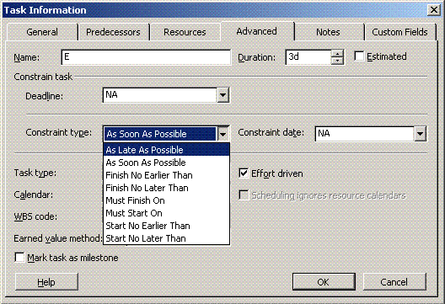
Scheduling Constraints
One of the most misunderstood aspects of Project Management Software
Inexperienced users will often use Must-Finish-On constraints in an attempt to ensure that the software will meet a contractual completion date
What they are actually doing is forcing the system to finish on that date and only that date
Better to use Finish-No-Later-Than; this constraint allows for completion before the specified date

Slide 61
Scheduling Constraints
As Soon As Possible (ASAP)
  Software will attempt to schedule the activity task to finish as soon as possible
  It is the default setting of Activities on most PM software
  It is ‘Flexible’ because the start and finish dates can be brought forward or pushed back in time in accordance with schedule logic only
As Late As Possible (ALAP)
  Software will attempt to schedule the activity to finish as late as possible
  Useful for Landscaping activities etc where it is preferable to start and finish ALAP in order to avoid damage
  It too is ‘Flexible’ because the start and finish dates can be brought forward or pushed back in time in accordance with schedule logic

Slide 62
Scheduling Constraints
Finish No Earlier Than (FNET)
  Software will attempt to schedule the activity to finish no earlier than a specified date; it will allow the task to finish after the specified date
Finish No Later Than (FNLT)
  Software will attempt to schedule the activity to finish no later than a specified date; it will allow the task to finish before the specified date
  i.e. construction of a pump plinth. It must finish no later than the date the pump is delivered to site, but can finish before this

Slide 63
Scheduling Constraints
Start No Earlier Than (SNET)
  Software will attempt to schedule the activity so that it starts no earlier than a specified date. It will allow the start date to be scheduled after this date, and is therefore considered semi-flexible
Start No Later Than (SNLT)
  Software will attempt to schedule the activity so that it will start no later than a specified date

Slide 64
Scheduling Constraints
Must Start On (MSO)
  Software will schedule the activity such that it starts on a specified date
  It is an inflexible constraint as it does not allow for any change to the start date whatsoever.
Must Finish On (MFO)
  Software will schedule the activity such that it will finish on a specified date
  It is an inflexible constraint as it does not allow for any change to the finish date.

Slide 65
General Comment on Scheduling Constraints
A flexible constraint sets a preference for either late or early completion
Semi-Flexible constraints will allow an activity to be started (or finished) either earlier or later, but not both
Inflexible constraints will not allow the activity’s start (or finish) date to change in any way.
Semi-Flexible and Inflexible constraints should never be used unless absolutely necessary
Semi-Flexible and Inflexible should never be used to ‘drive’ a project plan – that is for the PM team to do.
  i.e. Set SNLT on a task in an attempt to ensure task completion. (logic should do this for you)
Overuse of Semi and Inflexible constraints will force tasks onto the critical path that otherwise would not have to be critical

Slide 66
Typical Example

Slide 67
7
A

Slide 68
8
B
7
8
A
C
18
D

Slide 69
8
12
B
E
7
8
A
C
18
D

Slide 70
8
12
B
E
1
7
8
7
A
C
F
18
D

Slide 71
8
12
B
E
1
7
8
7
A
C
F
5
18
30
D
G

Slide 72
8
12
9
B
E
2
H
1
7
8
7
A
C
F
5
18
30
D
G

Slide 73
8
12
9
B
E
2
H
1
3
7
8
7
11
A
C
F
K
5
18
30
D
G

Slide 74
8
12
9
B
E
2
H
1
3
7
8
7
11
8
A
C
F
K
J
5
18
30
D
G

Slide 75
8
12
9
13
B
E
2
H
L
1
3
7
8
7
11
8
A
C
F
K
J
5
18
30
D
G

Slide 76
8
12
9
13
B
E
2
H
L
1
3
7
8
7
11
8
6
A
C
F
K
J
M
5
18
30
D
G

Slide 77
8
12
9
13
B
E
2
H
L
1
3
7
8
7
11
8
6
A
C
F
K
J
M
5
4
18
30
N
D
G

Slide 78
8
12
9
13
B
E
2
H
L
1
3
0
7
7
8
7
11
8
6
A
C
F
K
J
M
5
4
18
30
N
D
G

Slide 79
7
8
12
9
13
B
E
2
H
L
1
3
0
7
7
7
8
7
11
8
6
A
C
F
K
J
M
5
4
7
18
30
N
D
G

Slide 80
7
8
15
12
9
13
B
E
2
H
L
1
3
0
7
7
7
8
15
7
11
8
6
A
C
F
K
J
M
5
4
7
18
25
30
N
D
G

Slide 81
7
8
15
15
12
9
13
B
E
2
H
L
1
3
0
7
7
7
8
15
7
11
8
6
A
C
F
K
J
M
5
4
7
18
25
30
N
D
G

Slide 82
7
8
15
15
12
9
13
B
E
2
H
L
1
3
0
7
7
7
8
15
8
7
11
8
6
A
C
F
K
J
M
5
4
7
18
25
30
N
D
G

Slide 83
7
8
15
15
12
9
13
B
E
2
H
L
1
3
0
7
7
7
8
15
8
7
11
8
6
A
C
F
K
J
M
5
4
7
18
25
12
30
N
D
G

Slide 84
7
8
15
15
12
27
9
13
B
E
2
H
L
1
3
0
7
7
7
8
15
8
7
15
11
8
6
A
C
F
K
J
M
5
4
7
18
25
12
30
42
N
D
G

Slide 85
7
8
15
15
12
27
29
9
13
B
E
2
H
L
1
3
0
7
7
7
8
15
8
7
15
11
8
6
A
C
F
K
J
M
5
4
7
18
25
12
30
42
N
D
G

Slide 86
7
8
15
15
12
27
29
9
13
B
E
2
H
L
1
3
0
7
7
7
8
15
8
7
15
11
18
8
6
A
C
F
K
J
M
5
4
7
18
25
12
30
42
N
D
G

Slide 87
7
8
15
15
12
27
29
9
13
B
E
2
H
L
1
3
0
7
7
7
8
15
8
7
15
7
11
18
8
6
A
C
F
K
J
M
5
4
7
18
25
12
30
42
N
D
G

Slide 88
7
8
15
15
12
27
29
9
38
13
B
E
2
H
L
1
3
0
7
7
7
8
15
8
7
15
7
11
18
8
6
A
C
F
K
J
M
5
4
7
18
25
12
30
42
N
D
G

Slide 89
7
8
15
15
12
27
29
9
38
38
13
B
E
2
H
L
1
3
0
7
7
7
8
15
8
7
15
7
11
18
18
8
6
A
C
F
K
J
M
5
4
7
18
25
12
30
42
N
D
G

Slide 90
7
8
15
15
12
27
29
9
38
38
13
51
B
E
2
H
L
1
3
0
7
7
7
8
15
8
7
15
7
11
18
18
8
26
6
A
C
F
K
J
M
5
4
7
18
25
12
30
42
N
D
G

Slide 91
7
8
15
15
12
27
29
9
38
38
13
51
B
E
2
H
L
1
3
0
7
7
7
8
15
8
7
15
7
11
18
18
8
26
51
6
A
C
F
K
J
M
5
4
7
18
25
12
30
42
N
D
G

Slide 92
7
8
15
15
12
27
29
9
38
38
13
51
B
E
2
H
L
1
3
0
7
7
7
8
15
8
7
15
7
11
18
18
8
26
51
6
57
A
C
F
K
J
M
5
4
7
18
25
12
30
42
N
D
G

Slide 93
7
8
15
15
12
27
29
9
38
38
13
51
B
E
2
H
L
1
3
0
7
7
7
8
15
8
7
15
7
11
18
18
8
26
51
6
57
A
C
F
K
J
M
5
57
4
7
18
25
12
30
42
N
D
G

Slide 94
7
8
15
15
12
27
29
9
38
38
13
51
B
E
2
H
L
1
3
0
7
7
7
8
15
8
7
15
7
11
18
18
8
26
51
6
57
A
C
F
K
J
M
5
57
4
61
7
18
25
12
30
42
N
D
G

Slide 95
7
8
15
15
12
27
29
9
38
38
13
51
B
E
2
H
L
1
3
0
7
7
7
8
15
8
7
15
7
11
18
18
8
26
51
6
57
A
C
F
K
J
M
5
57
4
61
7
18
25
12
30
42
N
D
G

Slide 96
7
8
15
15
12
27
29
9
38
38
13
51
B
E
2
H
L
1
3
0
7
7
7
8
15
8
7
15
7
11
18
18
8
26
51
6
57
A
C
F
K
J
M
5
57
4
61
7
18
25
12
30
42
N
D
G

Slide 97
7
8
15
15
12
27
29
9
38
38
13
51
B
E
2
H
L
1
3
0
7
7
7
8
15
8
7
15
7
11
18
18
8
26
51
6
57
A
C
F
K
J
M
5
57
4
61
7
18
25
12
30
42
N
D
G
61

Slide 98
7
8
15
15
12
27
29
9
38
38
13
51
B
E
2
H
L
1
3
0
7
7
7
8
15
8
7
15
7
11
18
18
8
26
51
6
57
A
C
F
K
J
M
5
57
4
61
7
18
25
12
30
42
N
D
G
57
61

Slide 99
7
8
15
15
12
27
29
9
38
38
13
51
B
E
2
H
L
1
3
0
7
7
7
8
15
8
7
15
7
11
18
18
8
26
51
6
57
A
C
F
K
J
M
57
5
57
4
61
7
18
25
12
30
42
N
D
G
57
61
57

Slide 100
7
8
15
15
12
27
29
9
38
38
13
51
B
E
2
H
L
1
3
0
7
7
7
8
15
8
7
15
7
11
18
18
8
26
51
6
57
A
C
F
K
J
M
51
57
5
57
4
61
7
18
25
12
30
42
N
D
G
57
61
27
57

Slide 101
7
8
15
15
12
27
29
9
38
38
13
51
B
E
2
H
L
51
1
3
0
7
7
7
8
15
8
7
15
7
11
18
18
8
26
51
6
57
A
C
F
K
J
M
51
51
57
5
57
4
61
7
18
25
12
30
42
N
D
G
57
61
27
57

Slide 102
7
8
15
15
12
27
29
9
38
38
13
51
B
E
2
H
L
38
51
1
3
0
7
7
7
8
15
8
7
15
7
11
18
18
8
26
51
6
57
A
C
F
K
J
M
43
51
51
57
5
57
4
61
7
18
25
12
30
42
N
D
G
57
61
27
57

Slide 103
7
8
15
15
12
27
29
9
38
38
13
51
B
E
2
H
L
38
51
1
3
0
7
7
7
8
15
8
7
15
7
11
18
18
8
26
51
6
57
A
C
F
K
J
M
43
51
51
57
5
57
4
61
7
18
25
12
30
42
N
D
G
57
61
22
27
57

Slide 104
7
8
15
15
12
27
29
9
38
38
13
51
B
E
2
H
L
38
51
1
3
0
7
7
7
8
15
8
7
15
7
11
18
18
8
26
51
6
57
A
C
F
K
J
M
43
51
51
57
5
57
4
61
7
18
25
12
30
42
N
D
G
57
61
22
40
27
57

Slide 105
7
8
15
15
12
27
29
9
38
38
13
51
B
E
2
H
L
38
38
51
1
3
0
7
7
7
8
15
8
7
15
7
11
18
18
8
26
51
6
57
A
C
F
K
J
M
43
43
51
51
57
5
57
4
61
7
18
25
12
30
42
N
D
G
57
61
22
40
27
57

Slide 106
7
8
15
15
12
27
29
9
38
38
13
51
B
E
2
H
L
29
38
38
51
1
3
0
7
7
7
8
15
8
7
15
7
11
18
18
8
26
51
6
57
A
C
F
K
J
M
32
43
43
51
51
57
5
57
4
61
7
18
25
12
30
42
N
D
G
57
61
22
40
27
57

Slide 107
7
8
15
15
12
27
29
9
38
38
13
51
B
E
2
H
L
27
29
38
38
51
1
3
0
7
7
7
8
15
8
7
15
7
11
18
18
8
26
51
6
57
A
C
F
K
J
M
32
43
43
51
51
57
5
57
4
61
7
18
25
12
30
42
N
D
G
57
61
22
40
27
57

Slide 108
7
8
15
15
12
27
29
9
38
38
13
51
B
E
2
H
L
27
29
38
38
51
1
3
0
7
7
7
8
15
8
7
15
7
11
18
18
8
26
51
6
57
A
C
F
K
J
M
40
32
43
43
51
51
57
5
57
4
61
7
18
25
12
30
42
N
D
G
57
61
22
40
27
57

Slide 109
7
8
15
15
12
27
29
9
38
38
13
51
B
E
2
H
L
15
27
29
38
38
51
1
3
0
7
7
7
8
15
8
7
15
7
11
18
18
8
26
51
6
57
A
C
F
K
J
M
33
40
32
43
43
51
51
57
5
57
4
61
7
18
25
12
30
42
N
D
G
57
61
22
40
27
57

Slide 110
7
8
15
15
12
27
29
9
38
38
13
51
B
E
2
H
L
15
15
27
29
38
38
51
1
3
0
7
7
7
8
15
8
7
15
7
11
18
18
8
26
51
6
57
A
C
F
K
J
M
33
40
32
43
43
51
51
57
5
57
4
61
7
18
25
12
30
42
N
D
G
57
61
22
40
27
57

Slide 111
7
8
15
15
12
27
29
9
38
38
13
51
B
E
2
H
L
15
15
27
29
38
38
51
1
3
0
7
7
7
8
15
8
7
15
7
11
18
18
8
26
51
6
57
A
C
F
K
J
M
32
33
40
32
43
43
51
51
57
5
57
4
61
7
18
25
12
30
42
N
D
G
57
61
22
40
27
57

Slide 112
7
8
15
15
12
27
29
9
38
38
13
51
B
E
2
H
L
15
15
27
29
38
38
51
1
3
0
7
7
7
8
15
8
7
15
7
11
18
18
8
26
51
6
57
A
C
F
K
J
M
32
40
33
40
32
43
43
51
51
57
5
57
4
61
7
18
25
12
30
42
N
D
G
57
61
22
40
27
57

Slide 113
7
8
15
15
12
27
29
9
38
38
13
51
B
E
2
H
L
7
15
15
27
29
38
38
51
1
3
0
7
7
7
8
15
8
7
15
7
11
18
18
8
26
51
6
57
A
C
F
K
J
M
32
40
33
40
32
43
43
51
51
57
5
57
4
61
7
18
25
12
30
42
N
D
G
57
61
22
40
27
57

Slide 114
7
8
15
15
12
27
29
9
38
38
13
51
B
E
2
H
L
7
15
15
27
29
38
38
51
1
3
0
7
7
7
8
15
8
7
15
7
11
18
18
8
26
51
6
57
A
C
F
K
J
M
7
32
40
33
40
32
43
43
51
51
57
5
57
4
61
7
18
25
12
30
42
N
D
G
57
61
22
40
27
57

Slide 115
7
8
15
15
12
27
29
9
38
38
13
51
B
E
2
H
L
7
15
15
27
29
38
38
51
1
3
0
7
7
7
8
15
8
7
15
7
11
18
18
8
26
51
6
57
A
C
F
K
J
M
0
7
32
40
33
40
32
43
43
51
51
57
5
57
4
61
7
18
25
12
30
42
N
D
G
57
61
22
40
27
57

Slide 116
7
8
15
15
12
27
29
9
38
38
13
51
B
E
2
H
L
7
0
15
15
0
27
29
0
38
38
0
51
1
3
0
7
7
7
8
15
8
7
15
7
11
18
18
8
26
51
6
57
A
C
F
K
J
M
0
0
7
32
25
40
33
25
40
32
25
43
43
25
51
51
0
57
5
57
4
61
7
18
25
12
30
42
N
D
G
57
0
61
22
15
40
27
15
57

Slide 117
7
8
15
15
12
27
29
9
38
38
13
51
B
E
2
H
L
7
0
15
15
0
27
29
0
38
38
0
51
1
3
0
7
7
7
8
15
8
7
15
7
11
18
18
8
26
51
6
57
A
C
F
K
J
M
0
0
7
32
25
40
33
25
40
32
25
43
43
25
51
51
0
57
5
57
4
61
7
18
25
12
30
42
N
D
G
57
0
61
22
15
40
27
15
57

Slide 118
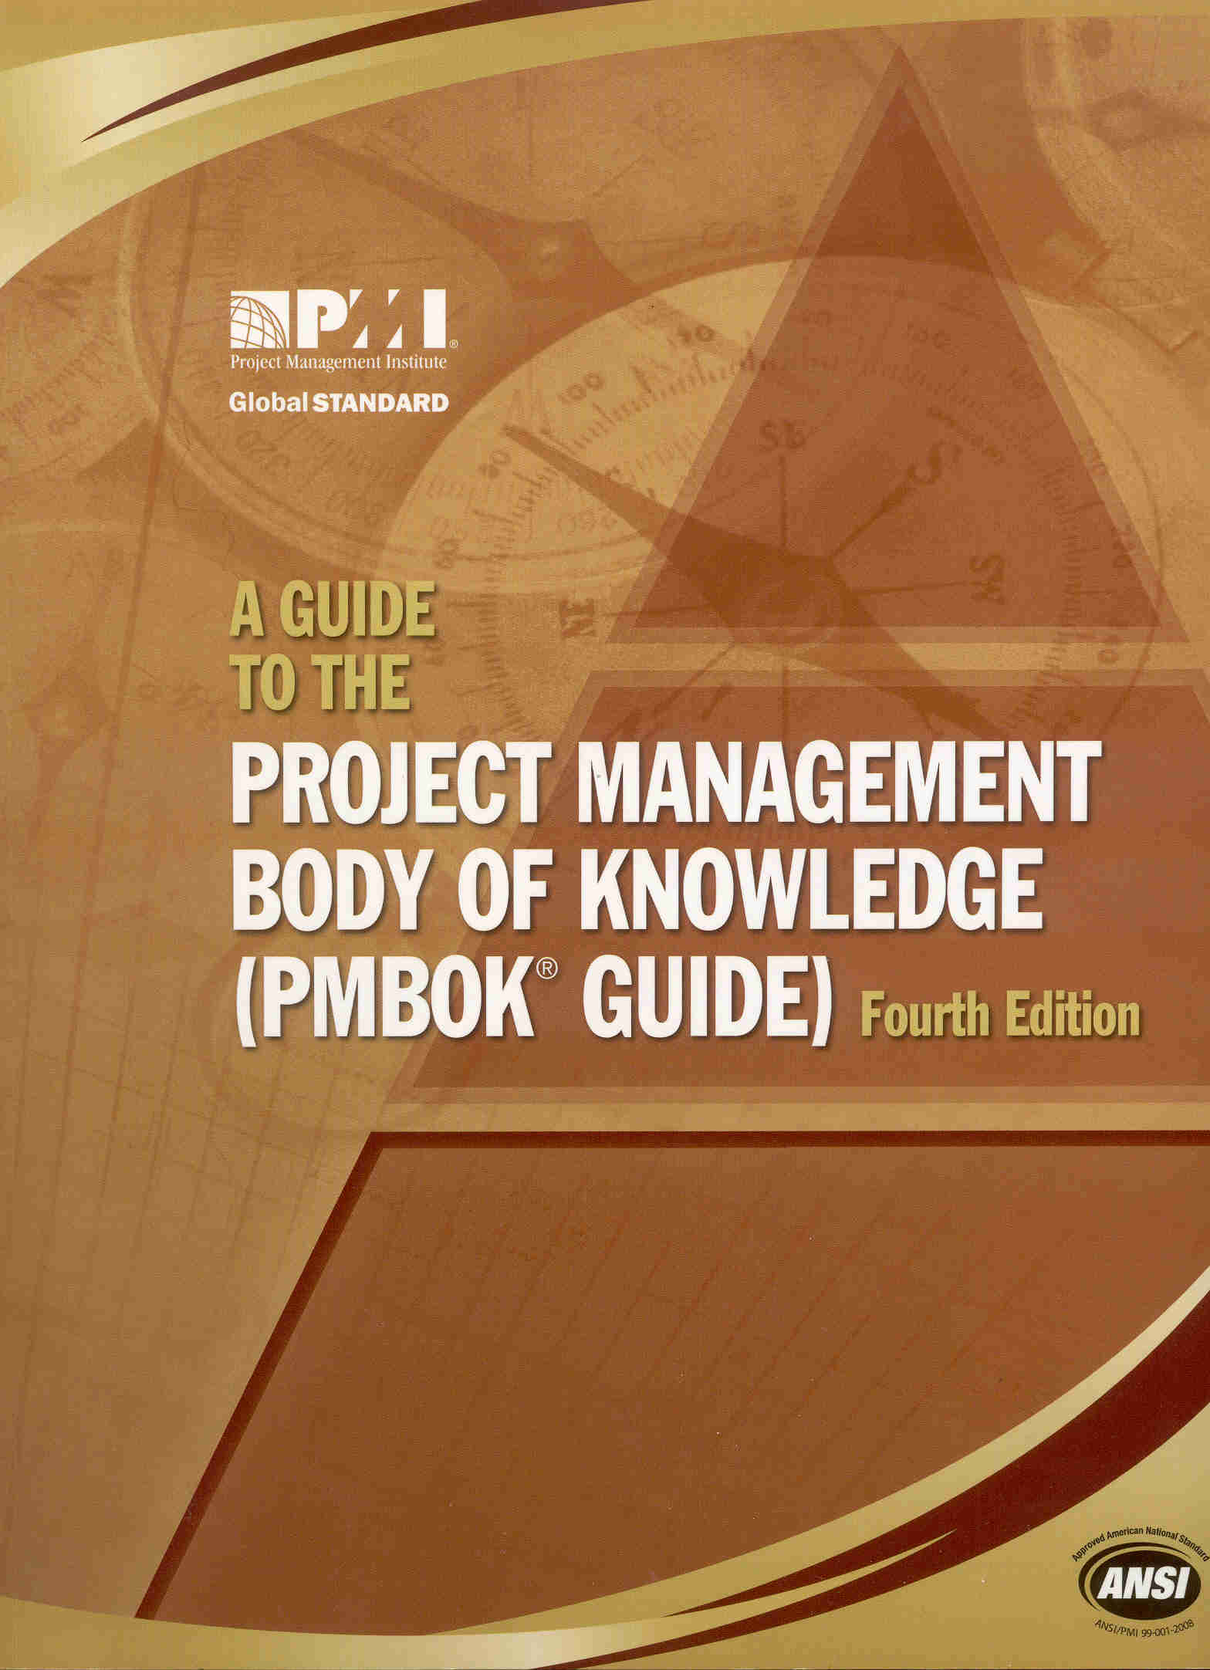
Next Lectures
  Line of Balance
Reading: ‘A Guide to the Project Management Body of Knowledge’ Chapters 5 & 6

